Slide 1
There was an idea...
IMLeagues is the go to sports application for intramural sports. All existing intramural teams use it.
Website is very flawed - littered with ads, has an old interface, unresponsive.
Solution to this was to make a new service that would rival IMLeagues' functionality, but without all of the clutter.
Notes:
D

Slide 2
INTRODUCING
Notes:
D

Slide 3

SWISH
An ITWS 1100 Final Project By Daniel Schnoll and Justin Chen
Notes:
D

Slide 4
Who knows of/has used IMLeagues before?
Notes:
J

Slide 5
Here’s the login page
Notes:
J

Slide 6
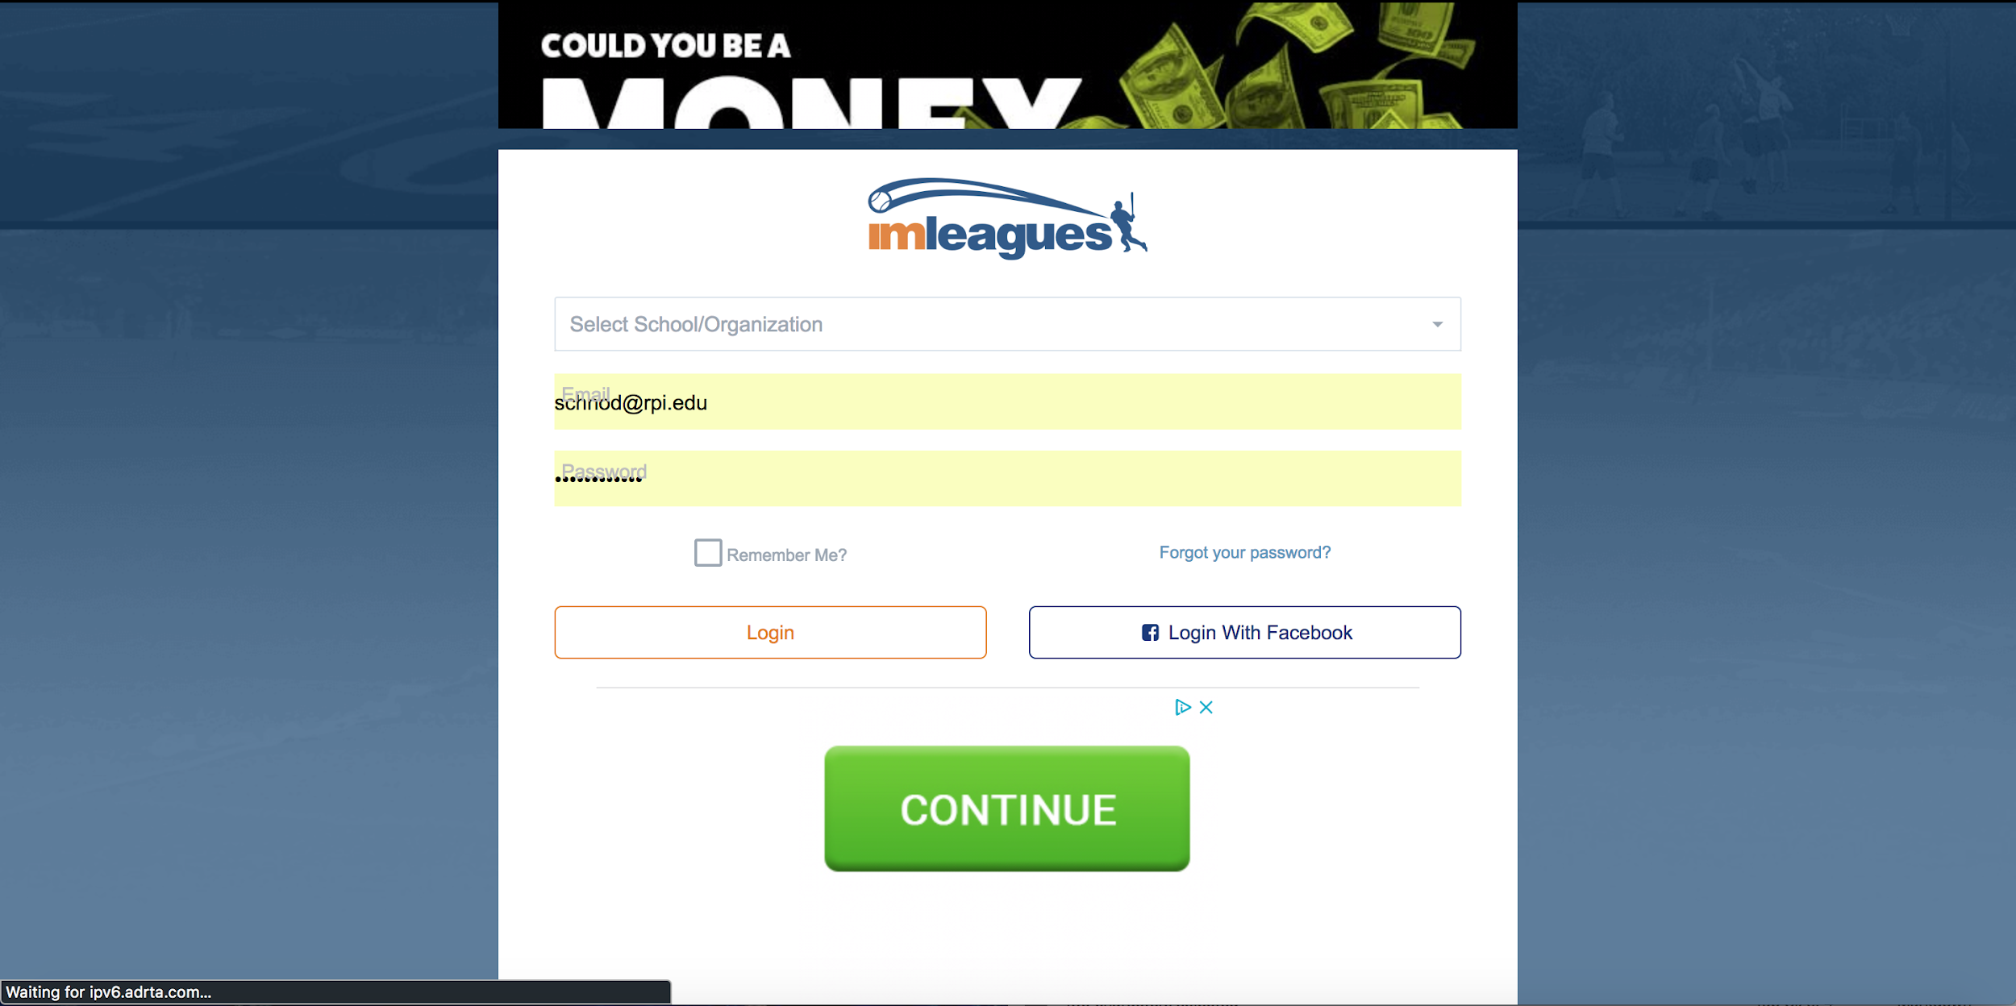

Notes:
J

Slide 7
Thought that was bad? Here’s the site itself...
Notes:
D

Slide 8
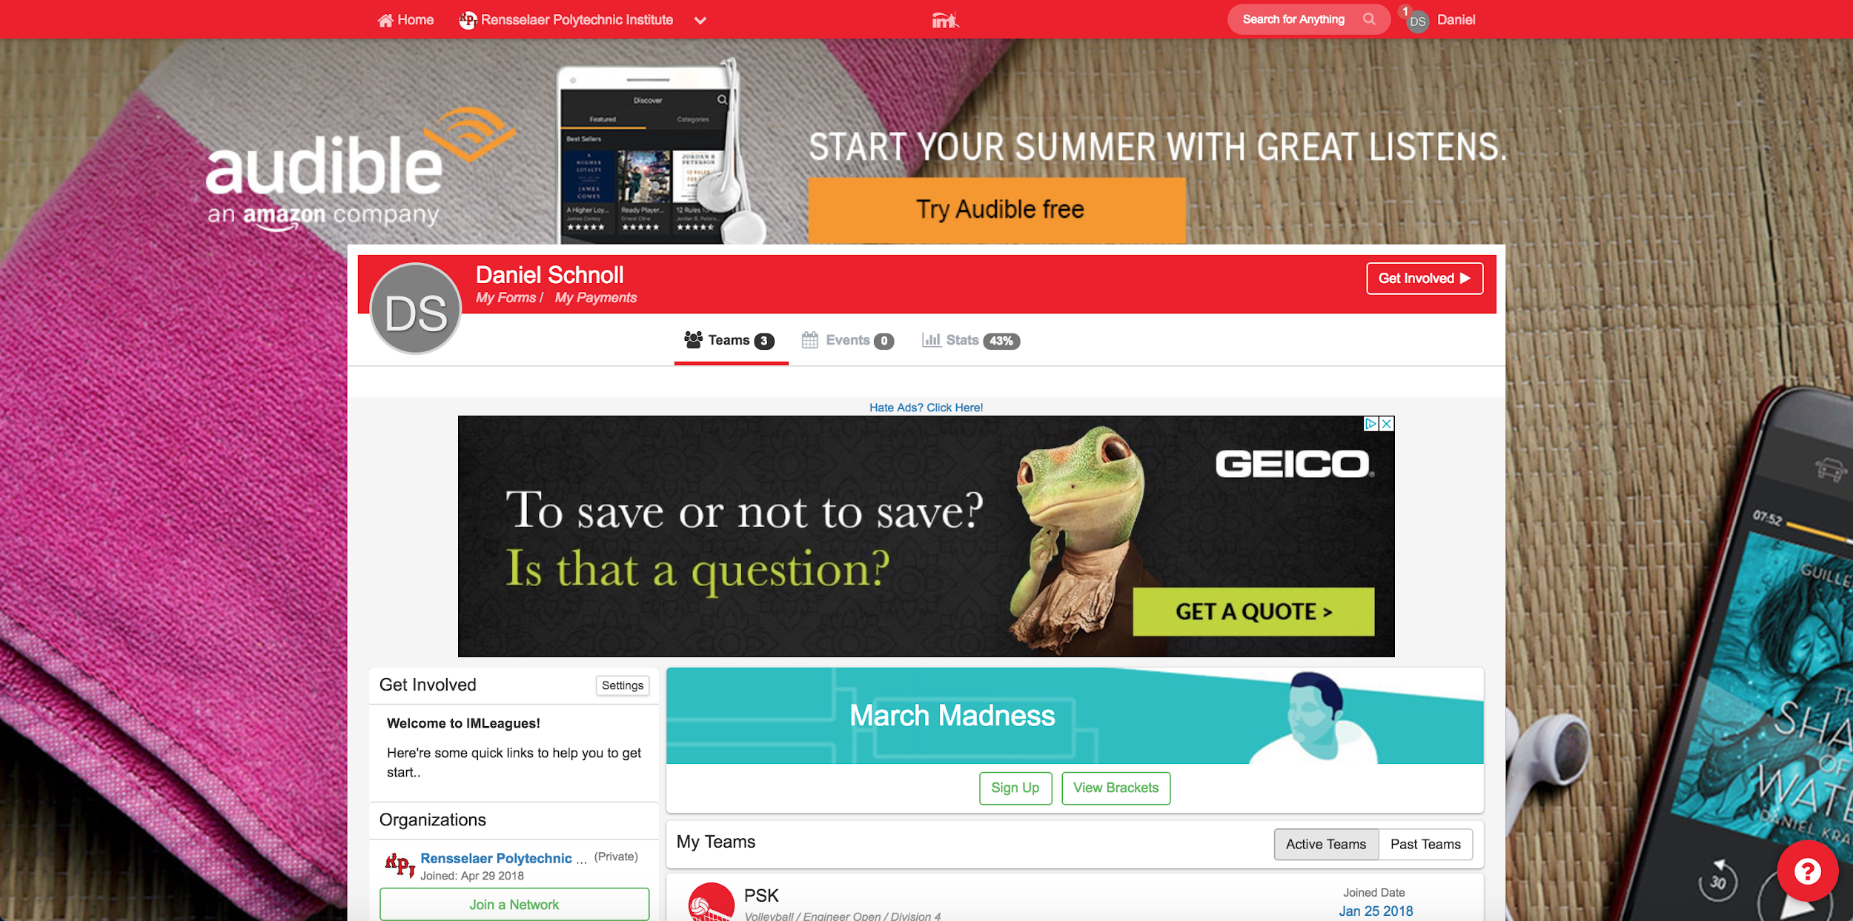
Notes:
D

Slide 9
The whole thing is an ad!
Notes:
J

Slide 10
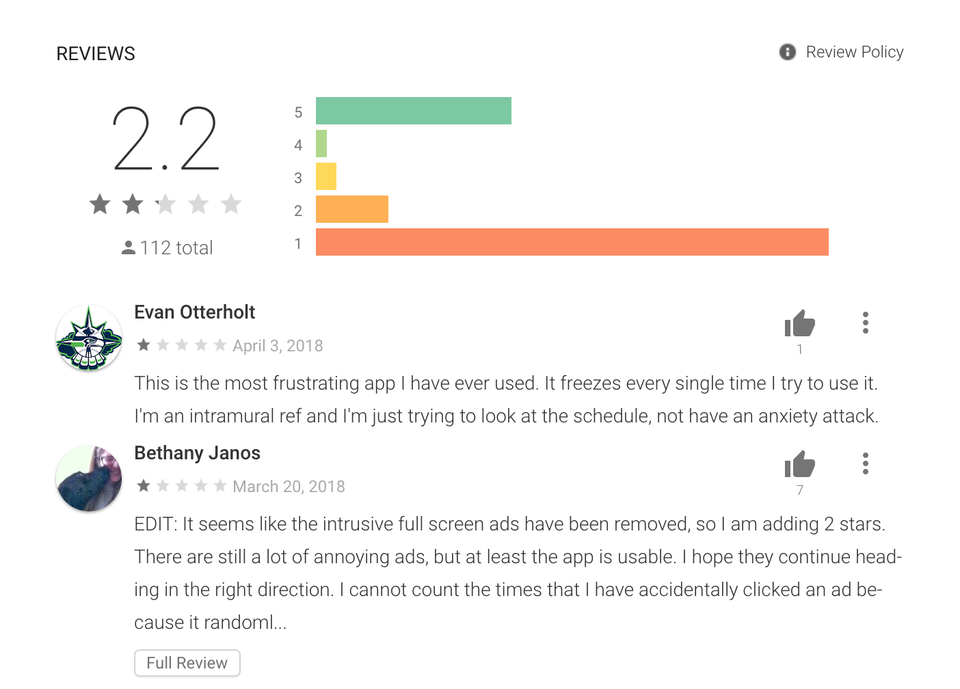
And everyone
agrees it’s bad
So let’s fix that!
Notes:
J

Slide 11
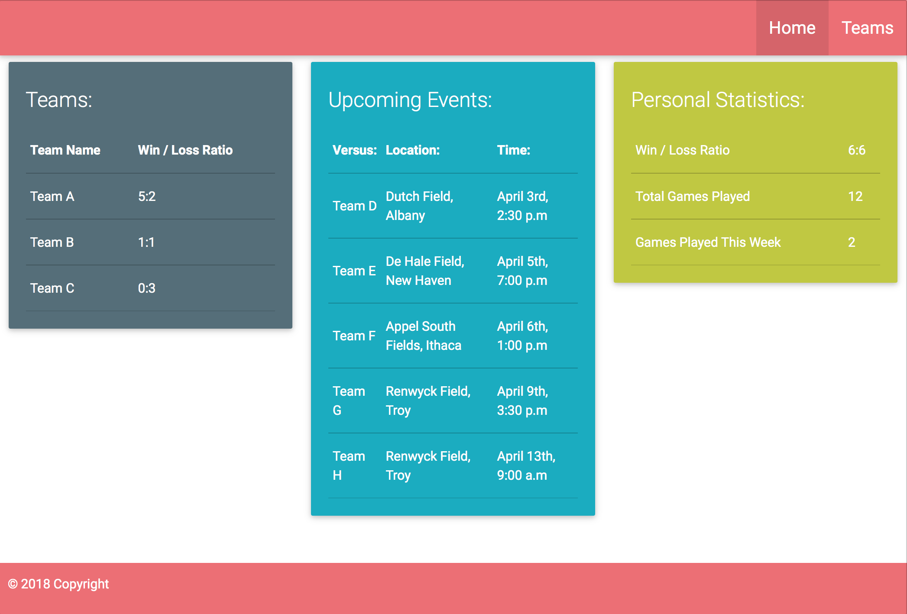
The Mockup
Initial layout design was a mockup profile page
Multiple colorful tables to distinguish different categories of information
Provides a quick look at all of your most important data
Includes, but is not limited to: Teams which you are a part of, Upcoming Events, and Personal stats such as a win loss ratio and total games played
Future features might include detailed performance report with additional data, such as points scored, penalties, and more
Notes:
D

Slide 12
The Features
Swish is still in its infancy
Has the core features that make it useful
“Login” landing page where you have the option to sign into your Swish account or make one if you don’t have one
Create account page where you fill out a form and create an account (also checks if your account exists)
Successful login redirects you to the Profile dashboard
Contains useful information like sports teams which you are a part of, Upcoming Events, and Personal stats such as a win loss ratio and total games played.
“Teams” page which allows you to make a new team, or join an existing one
Notes:
J

Slide 13
The Implementation
Decided to go with a LAMP (Linux, Apache, MySQL, PHP) stack for this project
Storing the data and information of many users -> we need a relational database
Could’ve been done with JSON but there were too many variables to account for
This allowed for a direct implementation of the Login and Account creation pages, both constructed with PHP
They establish a connection with a database and retrieve hashed password strings. If the account exists, it redirects to a profile page with all of your personalized information.
Design wise, we chose to go with the Materialize CSS library, which is based off of Google’s Material IO and provides a website with a modern and minimalistic appearance
Notes:
D

Slide 14
The Challenges
Biggest challenge by far was getting used to using PHP with the MySQL database
PHP is by far the newest language we learned in Intro to ITWS
Many of our SQL queries wouldn't work all because of a missing character or other slight syntax error ( ` vs ‘ )
After some Googling, we were able to figure it out
Notes:
J

Slide 15
The Future
Swish definitely has room to grow, as IMLeagues is clearly not a fan favorite.
There exists a market for a new intramural sports website
With the right tools and proper development, we can make Swish into a web application that is used on campuses across the country.
Notes:
D

Slide 16
The Demo

